Slide 1



OWASP ZAP HUD

Slide 2
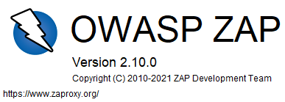


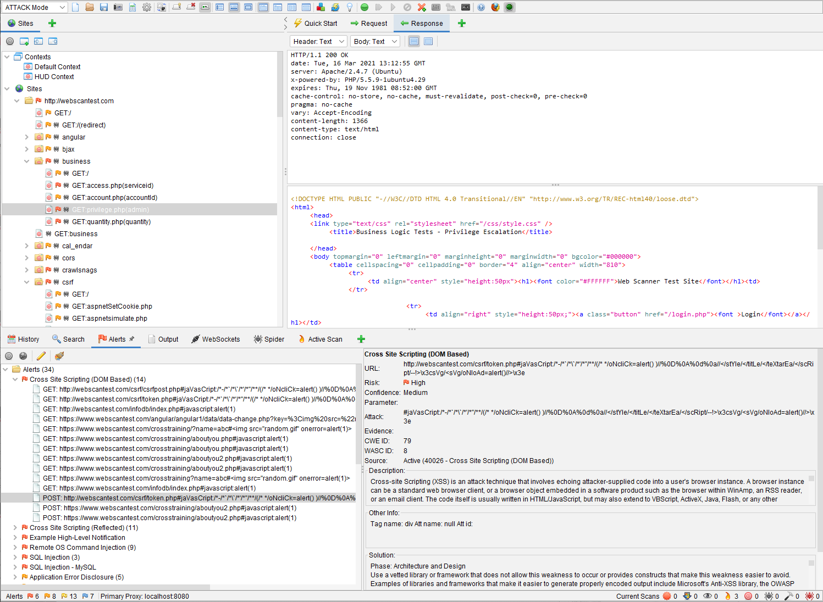
OWASP Zed Attack Proxy (ZAP)
An open-source web application scanner maintained by the Open Web Application Security Project (OWASP) which is catered towards individuals who are new to application security as well as professional penetration testers

Slide 3
Features
Built-in traditional and AJAX web crawlers (spiders), intercepting proxy server, automated and passive scanner, and fuzzer
Scan components (URLs, responses) can be exported so that they can be used/analyzed in other apps
OWASP Zed Attack Proxy (ZAP)
Allows the generation of reports based on the results of the scanner; various formats available (HTML, XML, JSON, Markdown)
Has add-on support for community-developed plugins for additional functionality

Slide 4


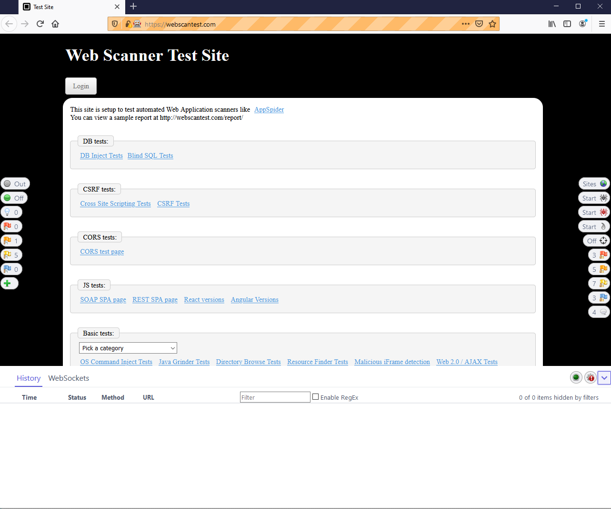
OWASP Zed Attack Proxy HUD
A completely new interface for ZAP that integrates the information and functionality of the scanner directly on the browser

Slide 5
Features
Provides the functionality of ZAP directly on the browser
Crawls and scans the web application as you navigate through it
OWASP Zed Attack Proxy HUD
All scan data is saved in a ZAP session and can be revisited later (for exporting, report generation, etc.)
Fairly unobtrusive user interface so it does not interfere with the view of the application; can also be disabled temporarily so it does not show up

Slide 6
Pros and Cons
Setup and use of ZAP HUD is very easy and even comes with a comprehensive tutorial
Not as fully-featured as the ZAP scanner or other scanning applications (BURP Suite, WebInspect, AppSpider)
EASE OF USE
LIMITED FUNCTIONALITY
Project is completely free to download and use under the Apache License
Plenty of known issues and bugs to be fixed; tested mostly on Firefox but should work on Chrome as well
OPEN-SOURCE
HUD CODE MATURITY
Minimal interface does not clutter the browser page while providing the core functionality of a scanner
Scanning and performance is not up to par like other web application scanners (BURP, WebInspect, AppSpider)
SMALL FOOTPRINT
SCANNING ACCURACY

Slide 7
Demonstration

Slide 8
Who should use it
Security testing teams without access to paid/premium application scanners
Developers performing testing on the target web application
Individuals who are just getting into the web application testing workflow
Security testing teams with other tools to serve as a supplementary scanner

Slide 9
References
OWASP Zed Attack Proxy (ZAP):
https://www.zaproxy.org/
OWASP ZAP Documentation:
https://www.zaproxy.org/docs/
OWASP ZAP GitHub Repository:
https://github.com/zaproxy/zaproxy
OWASP ZAP HUD GitHub Repository:
https://github.com/zaproxy/zap-hud
OWASP ZAP User Guide:
https://www.zaproxy.org/docs/desktop/
Web Scan Test Site:
https://www.webscantest.com/

Slide 10
THANK YOU!

